Slide 1
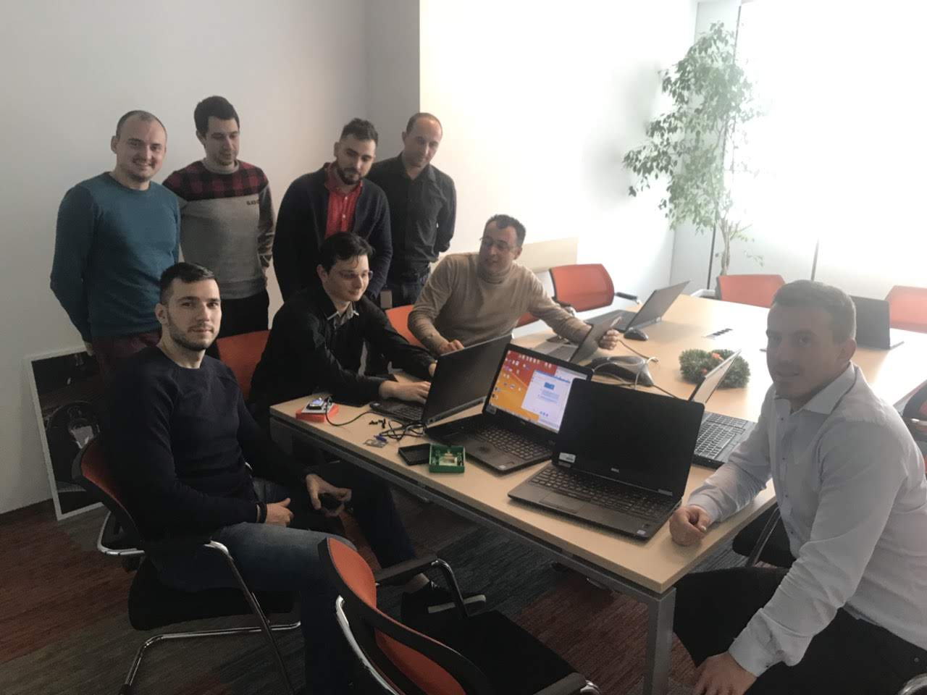
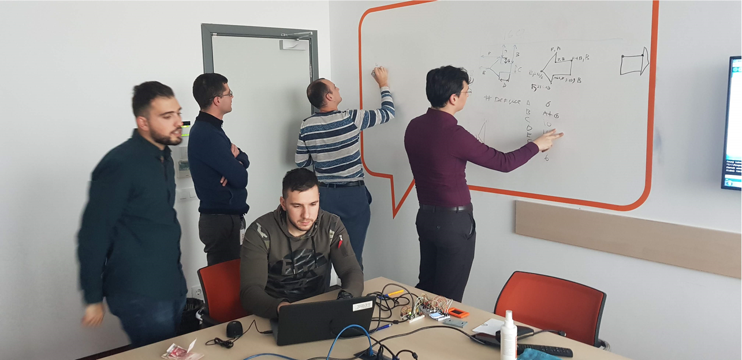
System Engineering in practice update

Slide 2
Customer requirements
Overview: The product is low-cost vehicle cluster with display, audio feedback device
SR1. For all visual information flow to the user the product shall support color display
SR2. The product HMI and vehicle data processing functions shall be independent
SR3. The product shall ensure integrity of communication
SR4. The product shall provide audible and visual clues for blinkers activated by digital input
SR5. The product shall support manufacturing and service configuration
SR6. The product shall inform the driver of external temperature
SR7. The product shall inform the driver of the vehicle mileage on the display based on the speed

Slide 3
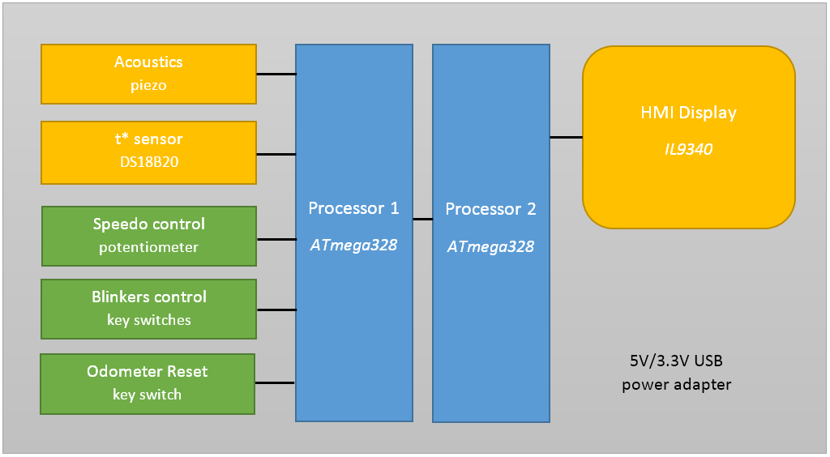
System architecture/overview
• SR1 - Display IL9340 • SR2 - 2 processors ATmega328
• SR3 - E2E protection on IPC communication • SR4 - piezo speaker and blinker key switches
• SR5 - diagnostics service • SR6 - t* sensor DS18B20 • SR7 - analog input – speedo control potentiometer

Slide 4
HW Architecture
BOM (Bill of materials) selection:
Processor – ATmega328 (8-bit, 16Kb)– 2pcs.;
Temperature sensor – DS18B20 (1-Wire Digital) – 1pc.;
Display (HMI) – QVGA 2.2 inch TFT (SPI, 240x320) – 1pc.;
- Later replaced by 1.8 inch TFT (SPI, 128x160) due to …wrong logic levels☺
Speaker – Piezo buzzer – 1pc.;
Oscillator – 16Mhz quartz crystal – 2pcs.;
Push/Switch button - DIP P4 Normally Open – 6 pcs.;
Potentiometer – Rotary Potentiometer (100kΩ) – 1 pc.;
Breadboard – 2pc.;
Capacitors, Resistors, Connectors, Wires, test LEDs and etc.

Slide 5
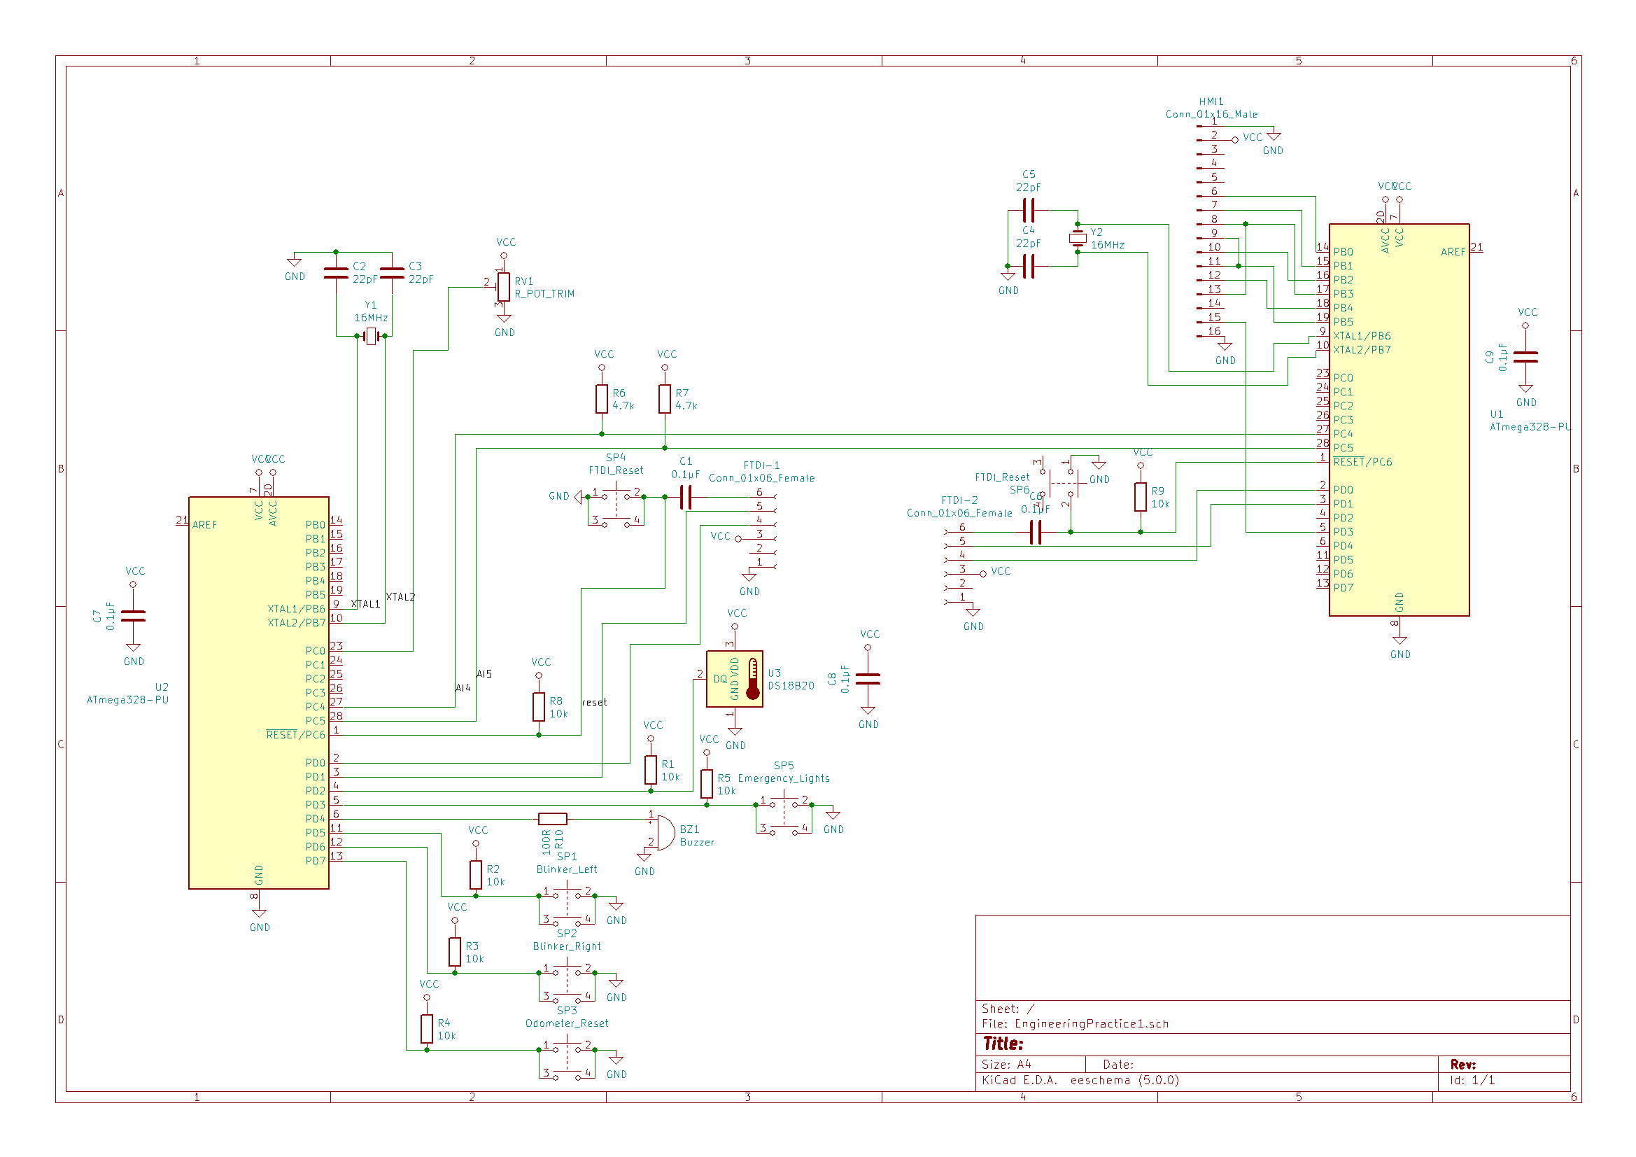
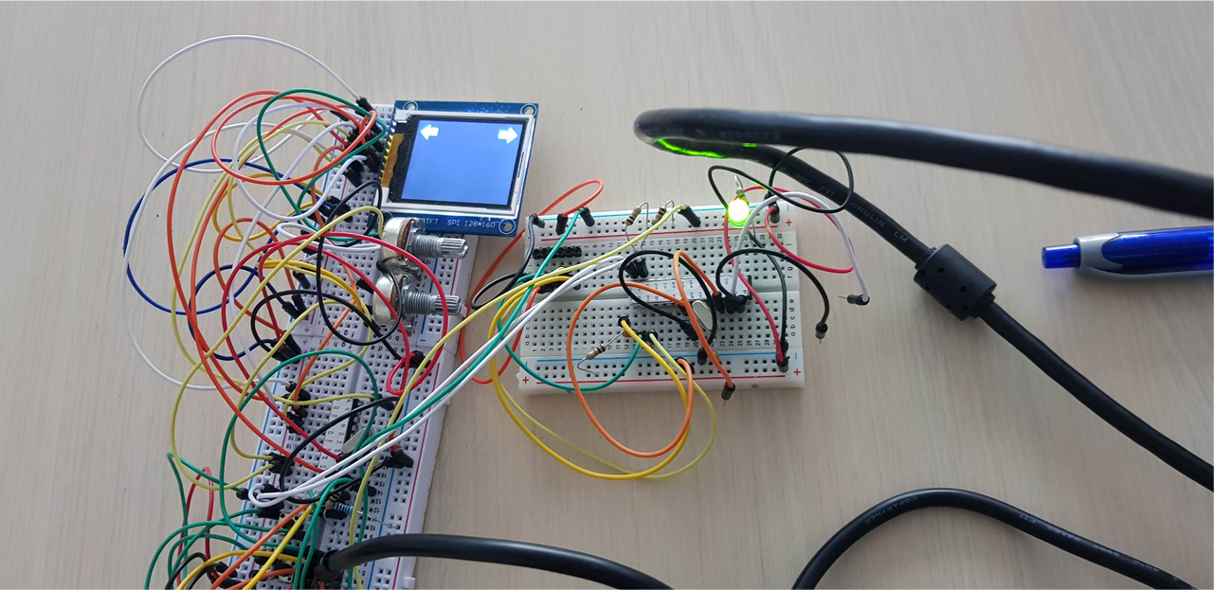
HW Schematic design

Slide 6
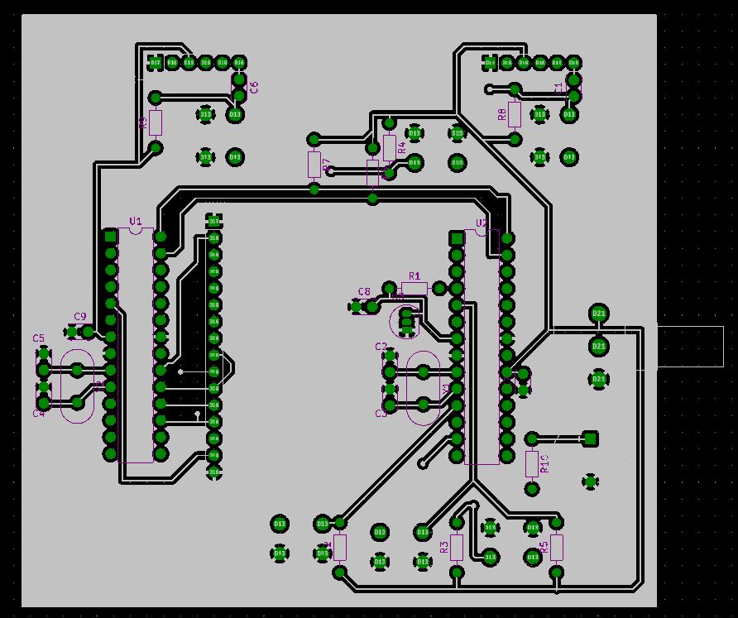
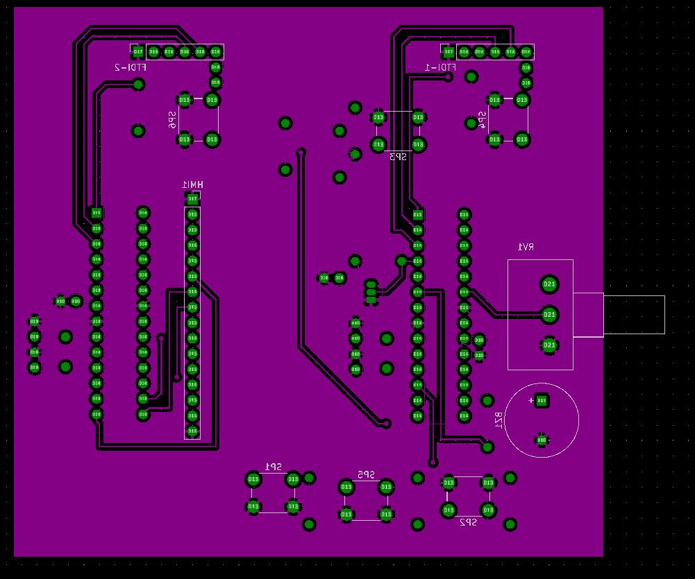
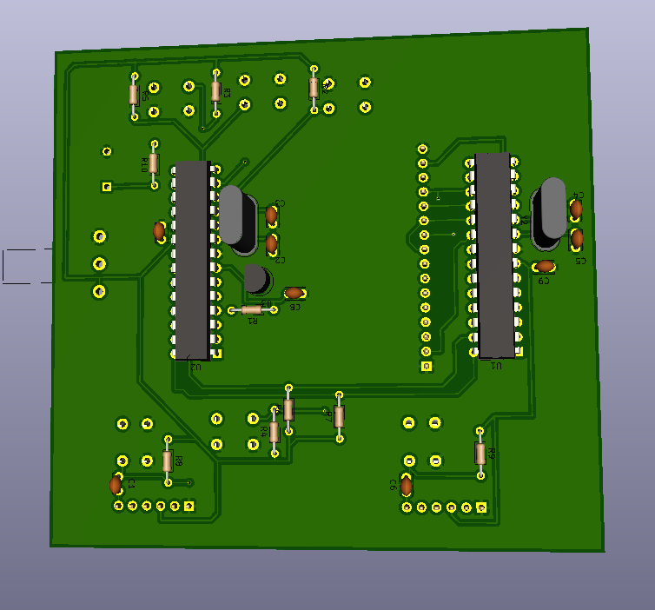
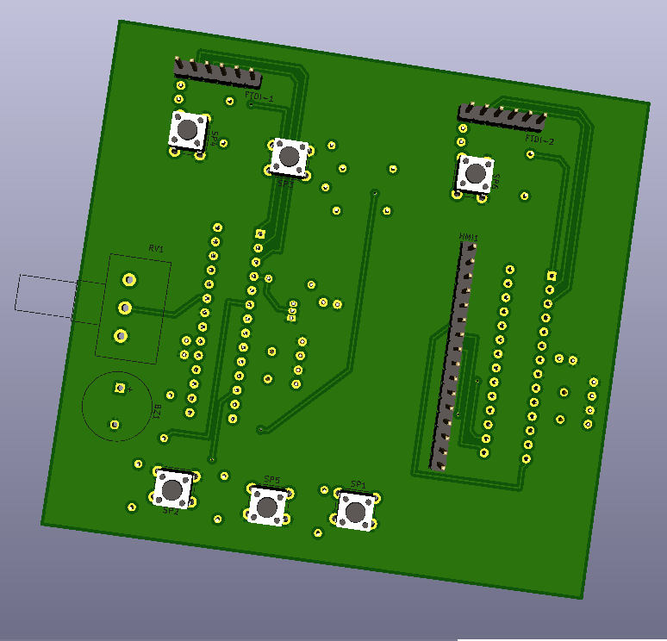
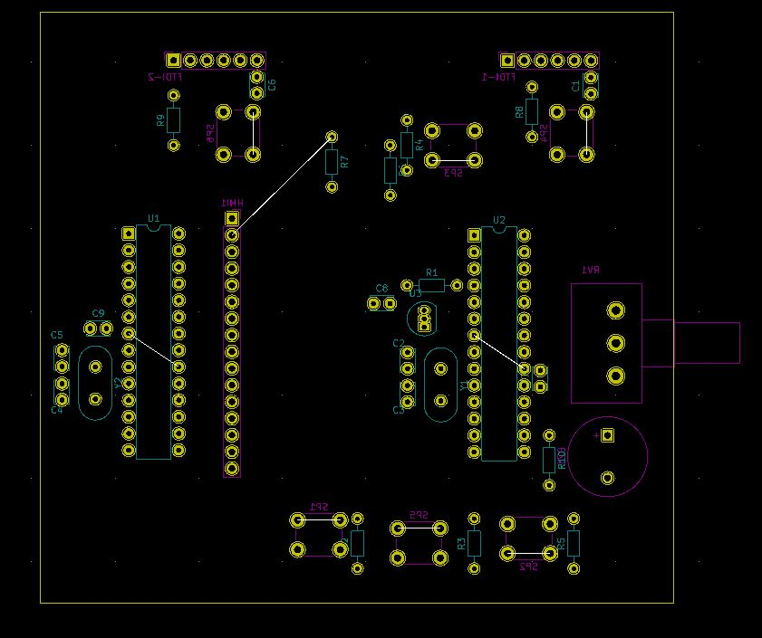
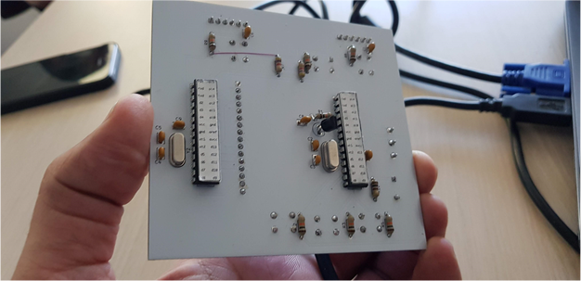
PCB Design
2 Layers PCB:
- 100x100mm;
- ground plane fill;
Result & Lessons
learned:
- don’t miss connections

Slide 7
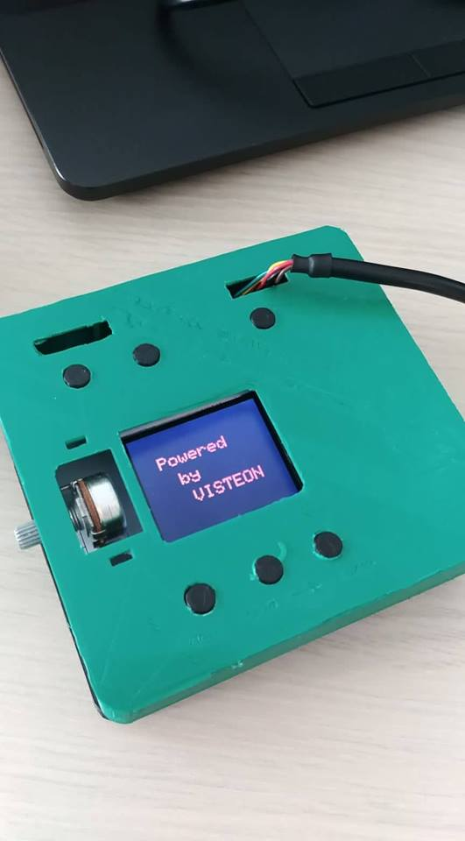
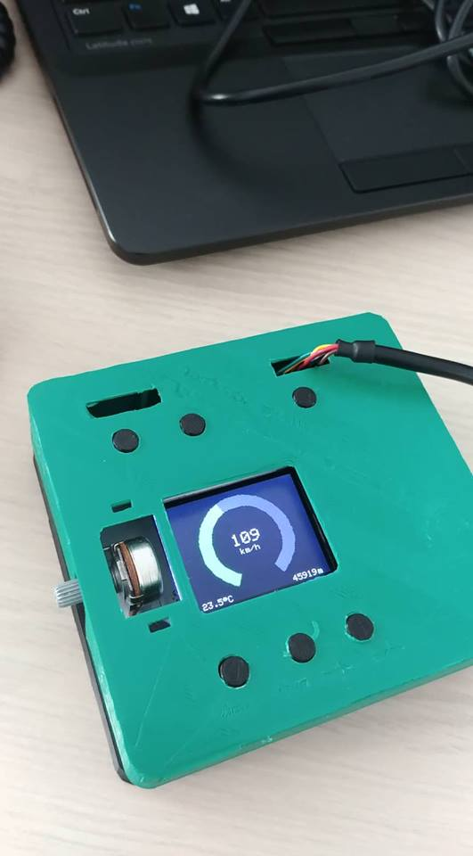
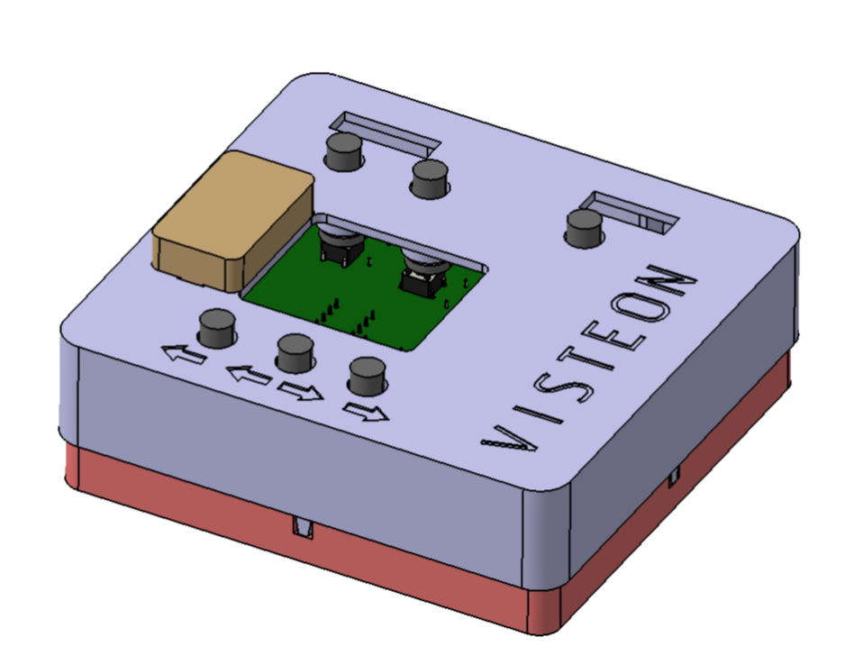
Mechanics

Slide 8
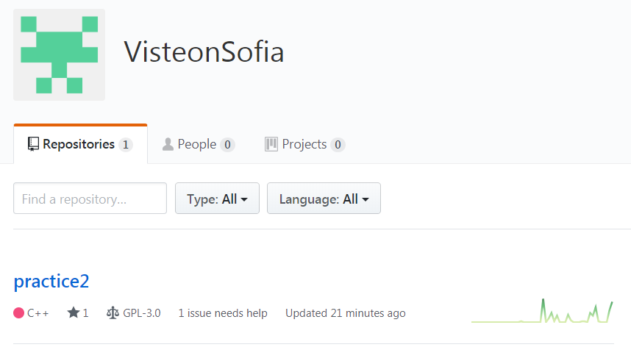
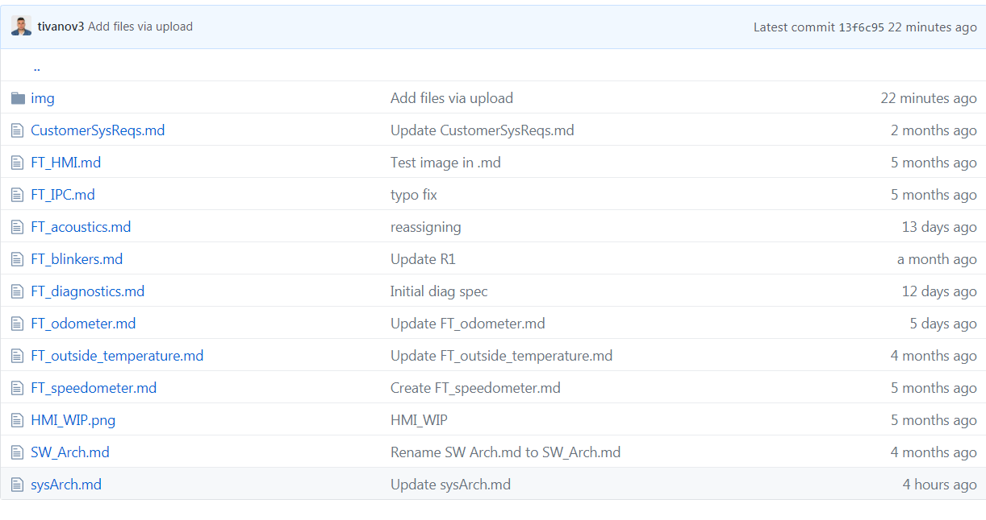
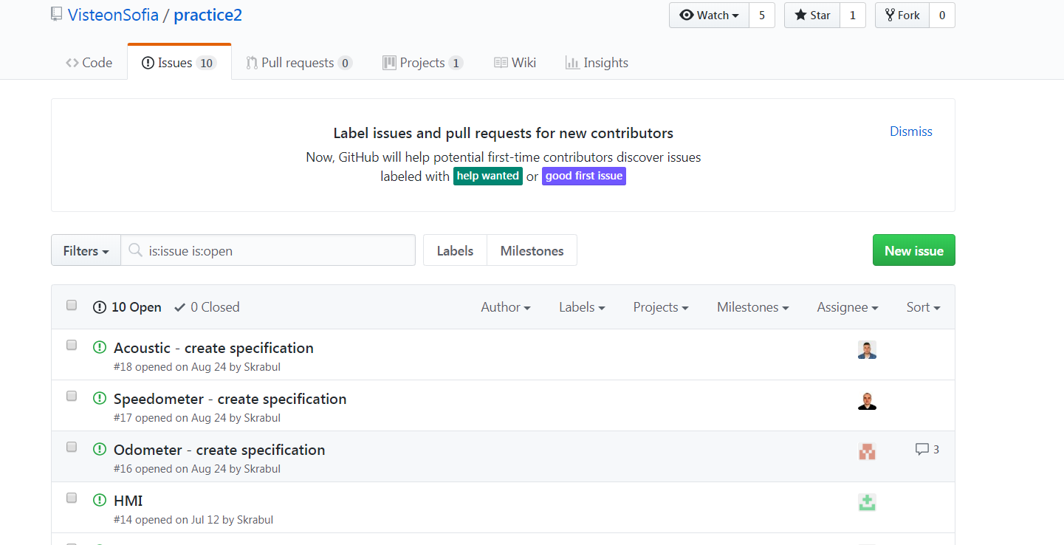
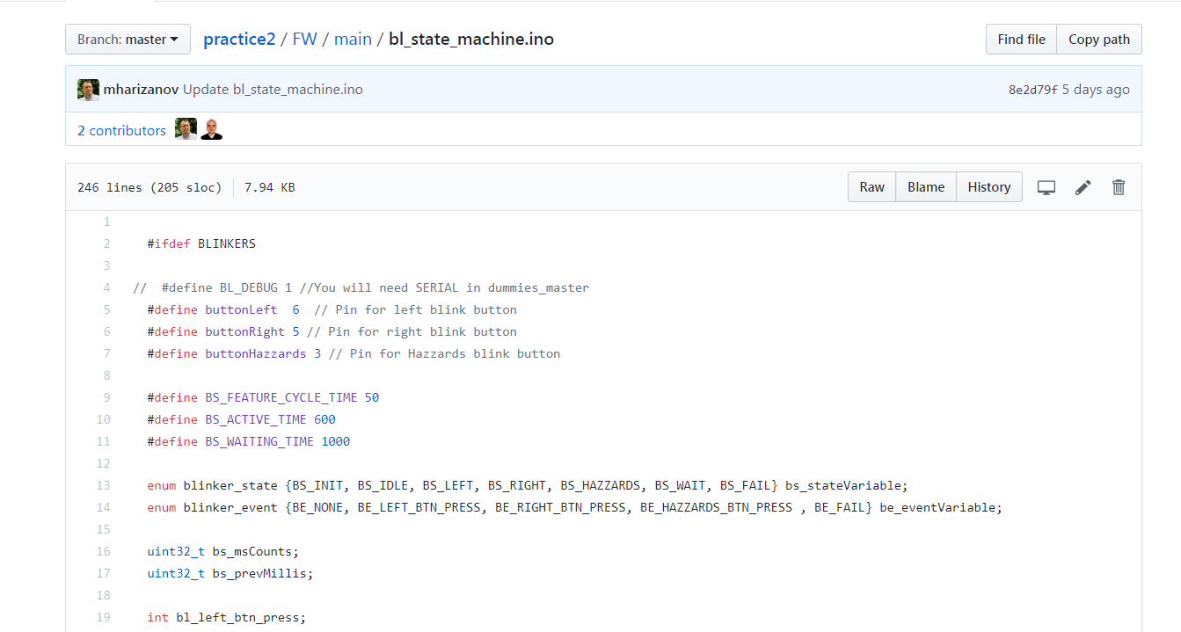
Github Collaboration

Slide 9
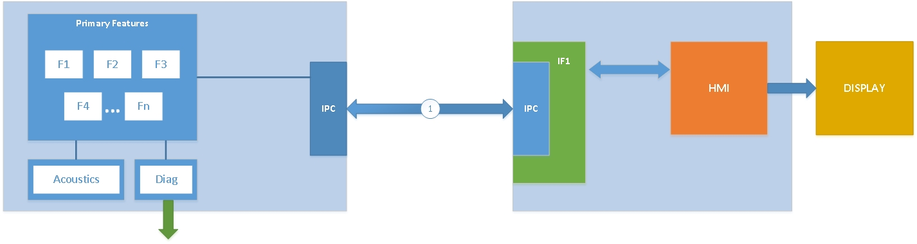
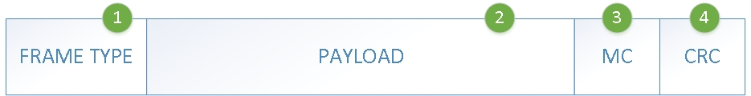
SW architecture
E2E

Slide 10
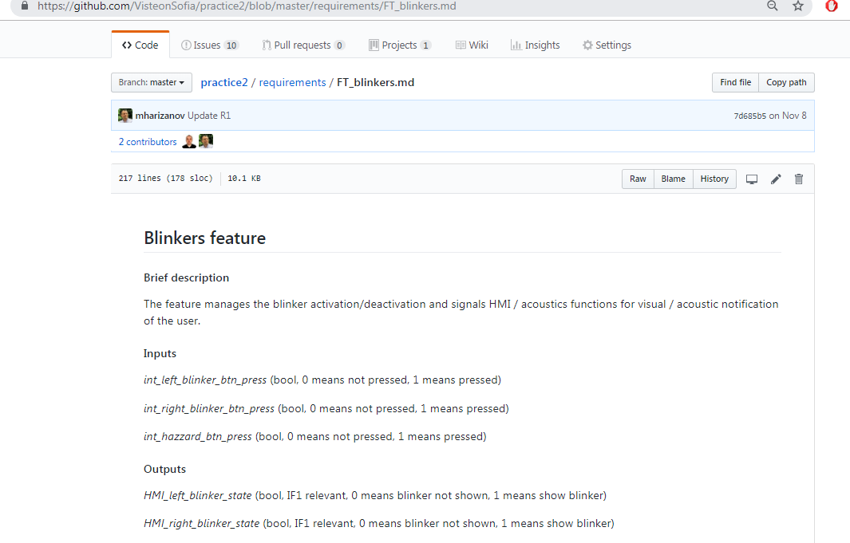
SW requirements
Managed on GitHub

Slide 11
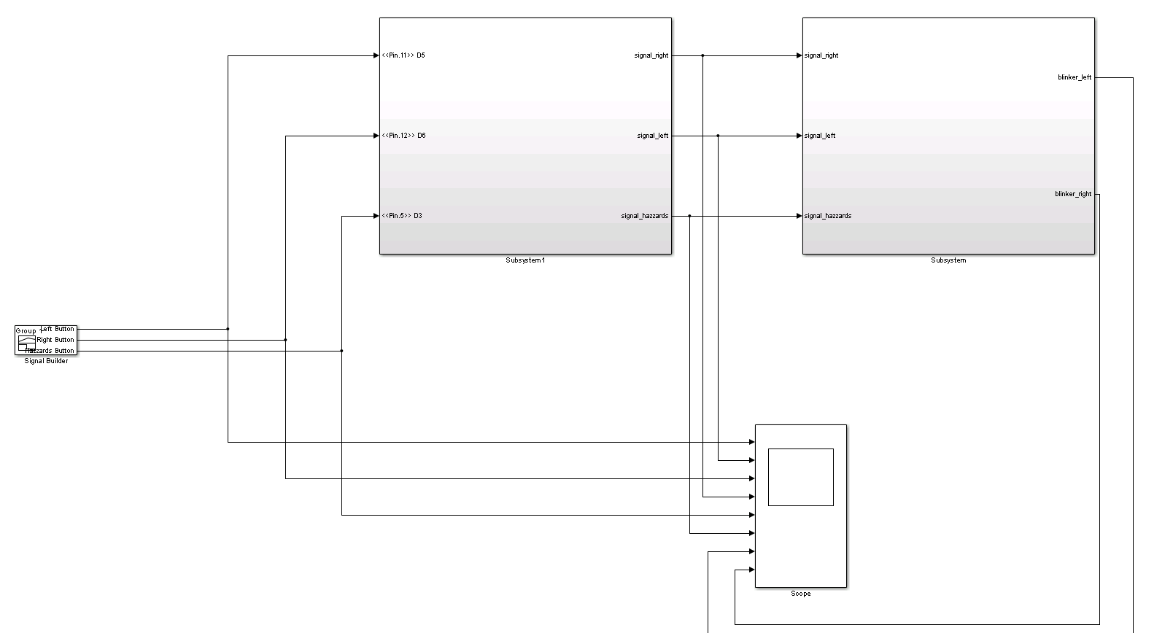
Matlab model “blinkers” SWC

Slide 12
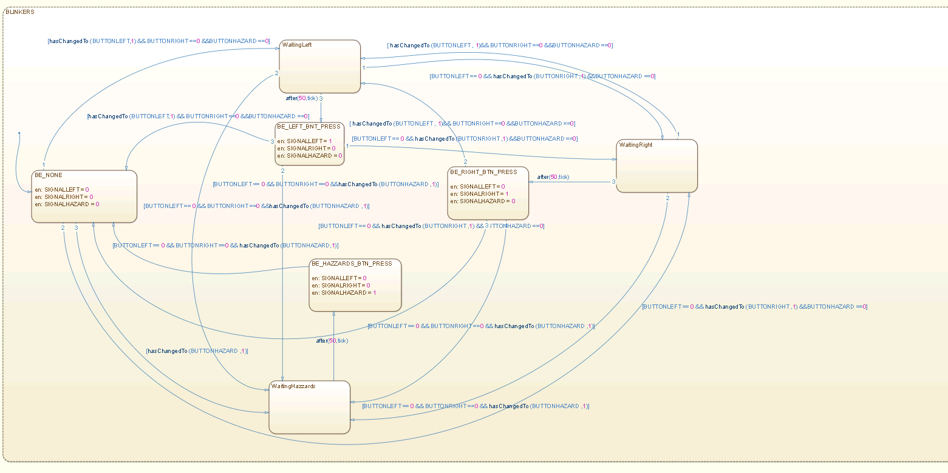
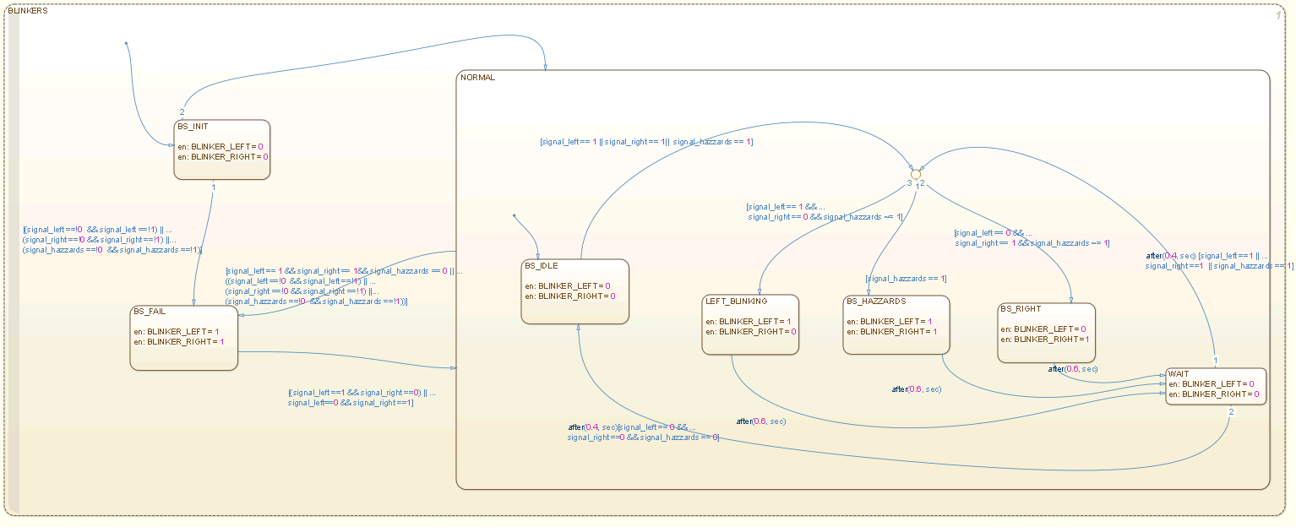
Matlab model “blinkers” SWC

Slide 13
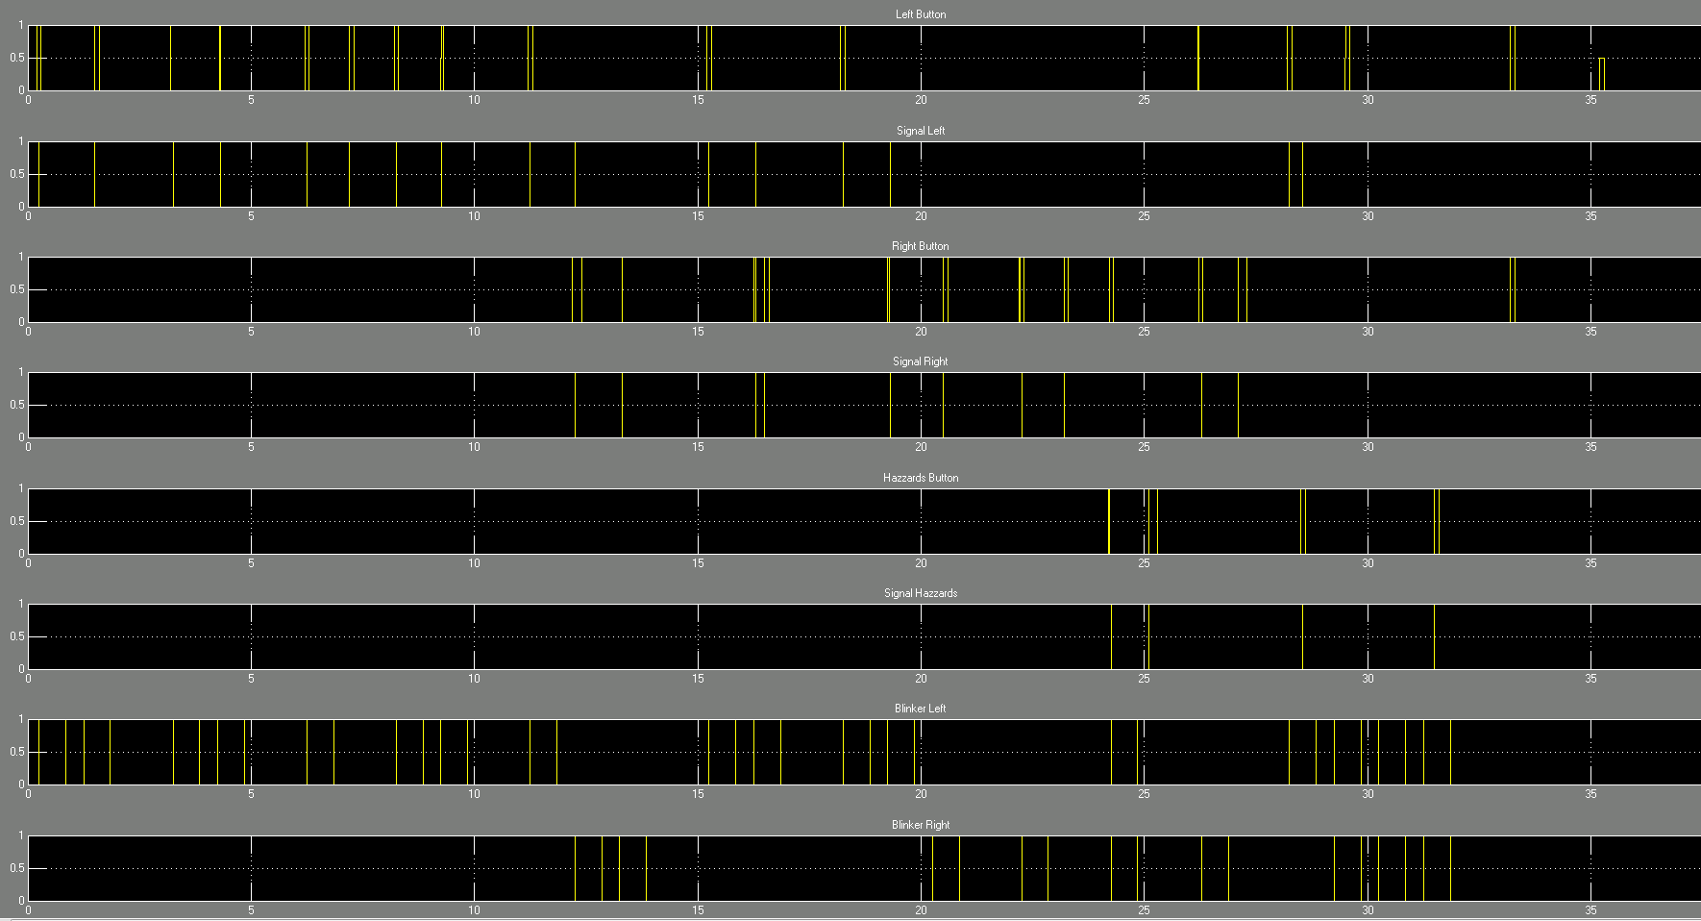

Slide 14
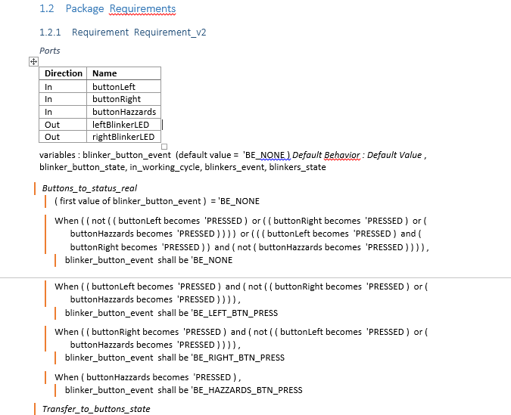
Natural language modeled requirements

Slide 15
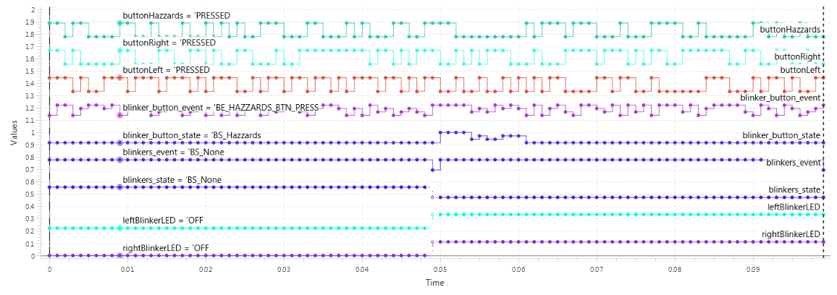
Time diagram

